Slide 1

Swing Overview
AWT and Swing
Components
Layouts
Events

Slide 2

See Also
https://www.youtube.com/watch?v=dTVVa2gfht8
http://zetcode.com/tutorials/javaswingtutorial/
Notes:
Some additional information on concurrency

Slide 3
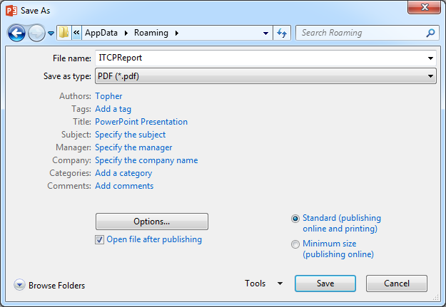
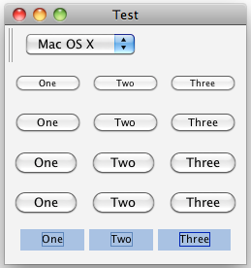
First: AWT
Advanced Window Toolkit
JNI reference to native OS (Windows, OSX, etc.)
Native speed
Generic API … misses some OS specifics

Slide 4
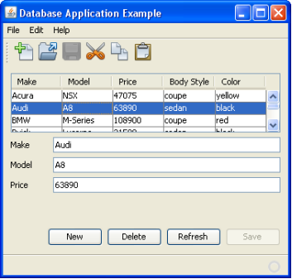
Then: Swing
Pure Java-drawn GUI
Can look the same on every platform
Different themes (even platform look and feel)
Performance has gotten better

Slide 5
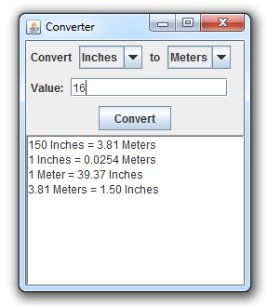
Swing Components
JLabel
JComboBox
JButton
JTextField
JTextArea

Slide 6
Swing Containers
JFrame
JPanel

Slide 7
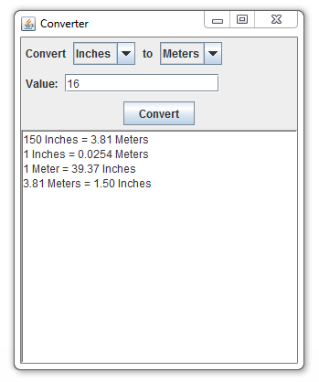
Layout Managers
Left justified and do not stretch. Empty space goes to right.
Centered on line. Space divided on left and right.
Area stretches to fill all extra space.

Slide 8
Events
WhenValueChanges
Change the values in the “to” list.
WhenKeyTyped
If “Enter” then do the conversion.
WhenClicked
Do the conversion.
Do the conversion:
Get values for “from” and “to”
Get the “value”
Do the conversion
Add result to the history list

Slide 9
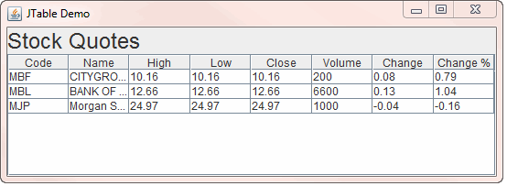


Complex Components
Model
Viewer
How many columns?
What is the type of column 2?
How many rows?
What is the value for row 1, column 4?
The user changed 1,4 to value “Blue”.
Your code
A new row has been added.
The value for 1,4 has changed to “Green”.
Server
Database

Slide 10

GUIs Everywhere
GUI programming is similar most everywhere
Components, layouts, callbacks, models
HTML/Javascript, Flex, MFC, Python (wxpython), android
Learn to think in callbacks

Slide 11

Tinkering
Sketch the UI layout for a Swing version of the Chat program. Do you want it to look the same as the web version?
How does the Chat application respond to resizing?

